Slide 1

Programming Project Milestone 2
Presented By:
Resego Letsholo
Tadiwanashe Nyoka
Nomsa Mavunda
Aidan Beckley

Slide 2
Presentation Layer
The Presentation Layer serves as the application's user interface and is in charge of communicating with end users. It alludes to the Windows Forms GUI in this project.
Its duties consist of:
Putting the UI components (textboxes, buttons, forms, etc.) on display,
Managing events and inputs from users,
Information is presented to the user,
Gathering user input to be processed further,
Verifying user inputs (per the specifications provided by the client).

Slide 3
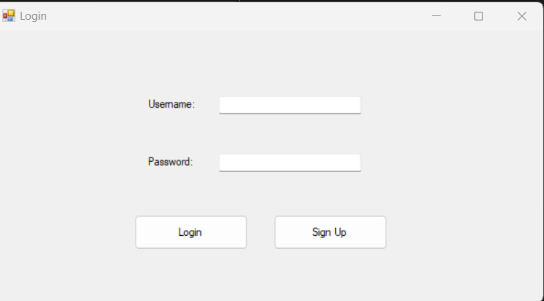
Login Form

Slide 4
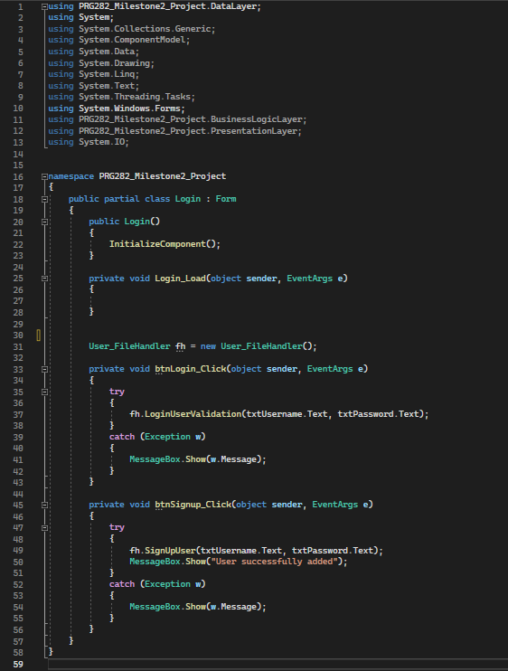
Login Form Code

Slide 5
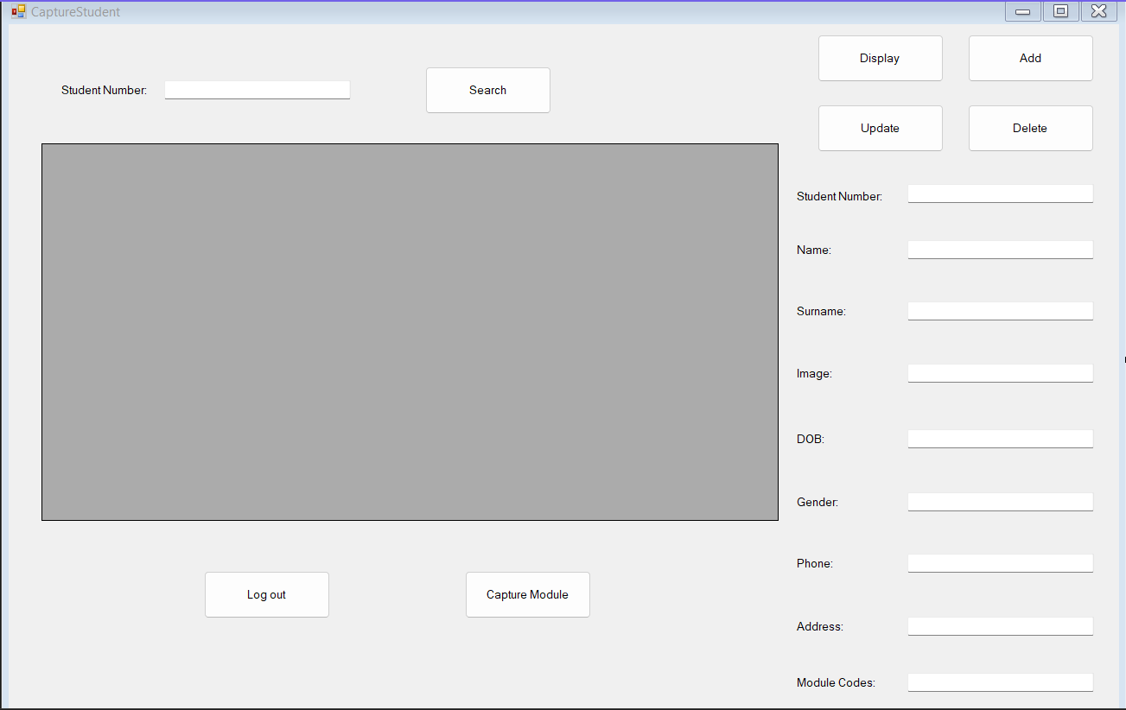
Student Details Form

Slide 6
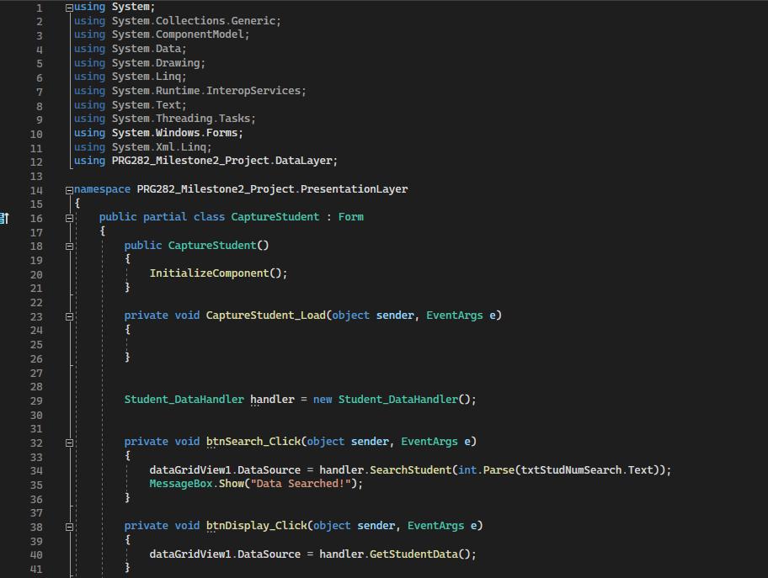
Student Form Code

Slide 7
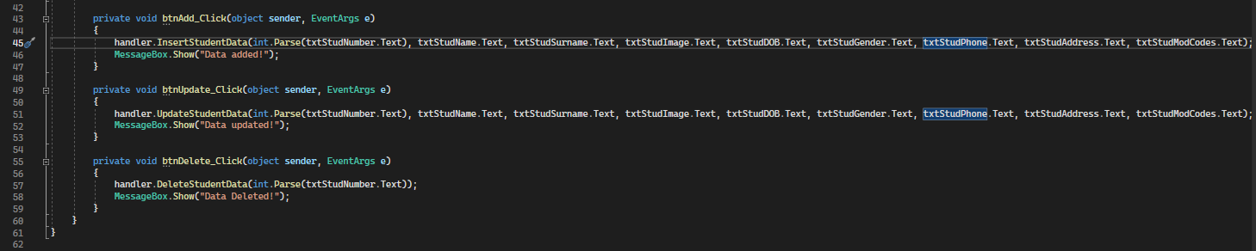

Slide 8
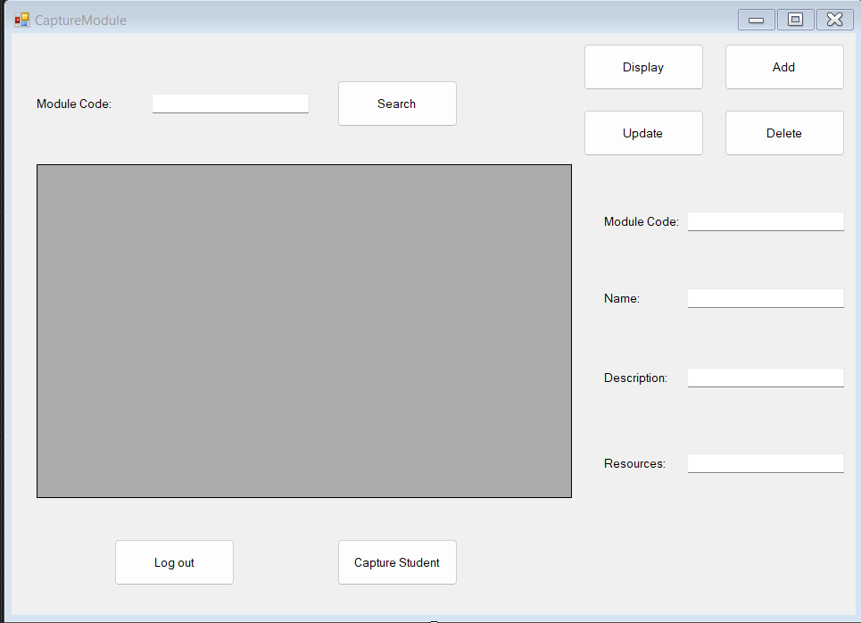
Module Class Form

Slide 9
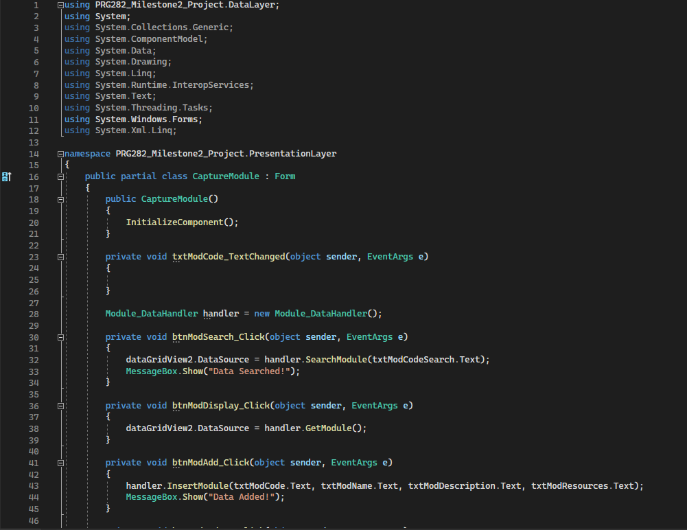
Module Form Code

Slide 10
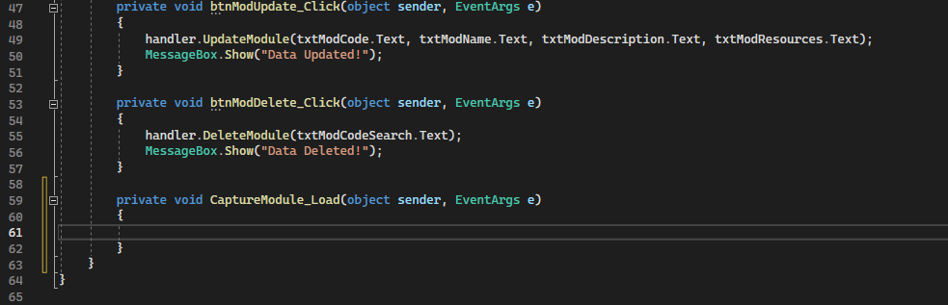

Slide 11
Business Layer
The application's main functionalities are found in the Business Logic Layer. It manages the logic, business rules, and procedures of the programme without regard to the user interface or data storage systems.
Its responsibilities are:
CRUD (Create, Read, Update, Delete) methods are being implemented for student and module data,
Executing I/O operations for files,
Data processing and validation prior to engaging with the Data Access Layer,
Managing regulations and standards unique to a business.

Slide 12
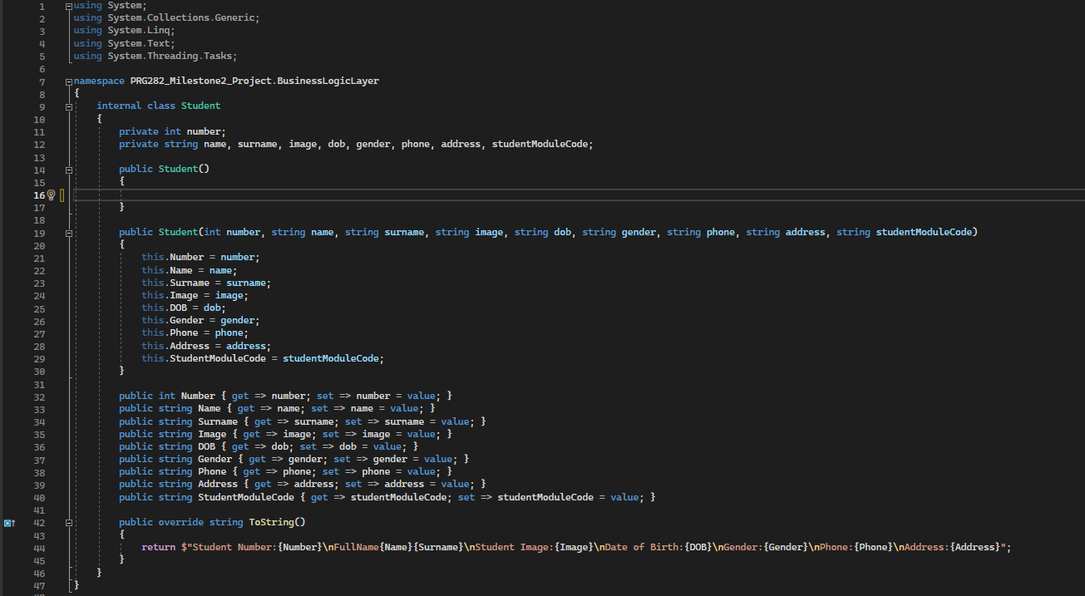
Student Class

Slide 13
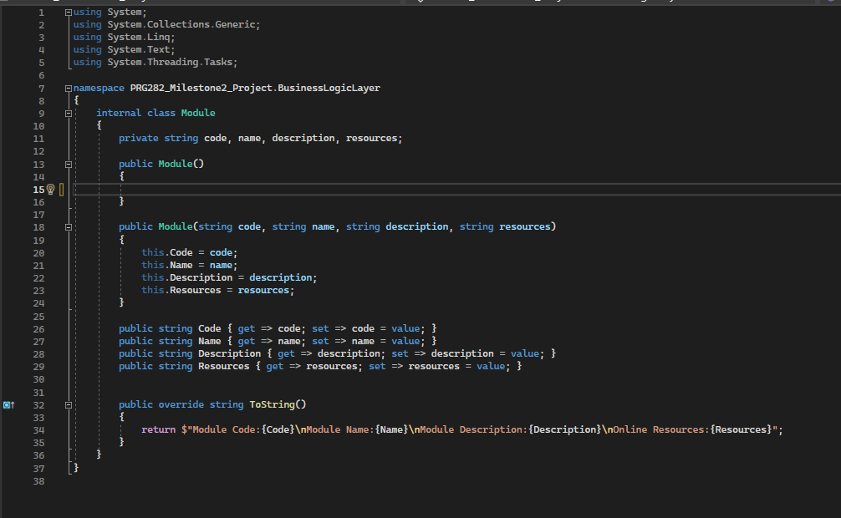
Module Class

Slide 14
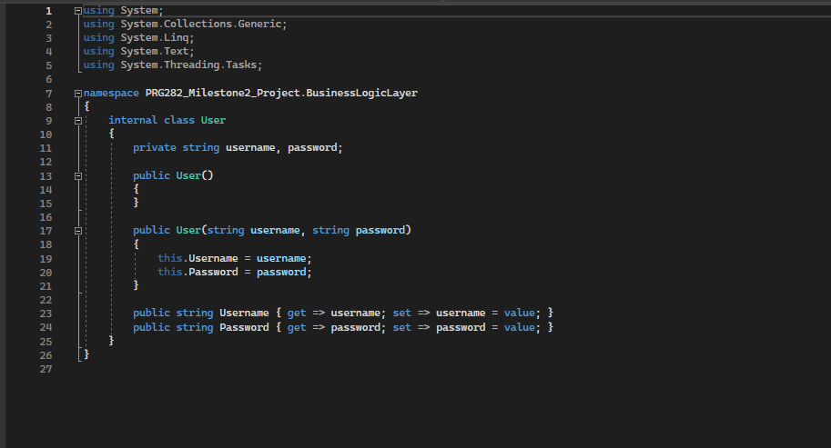
User Class

Slide 15
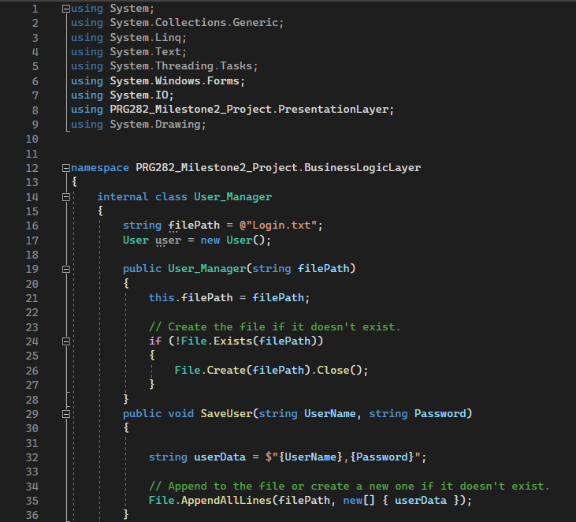
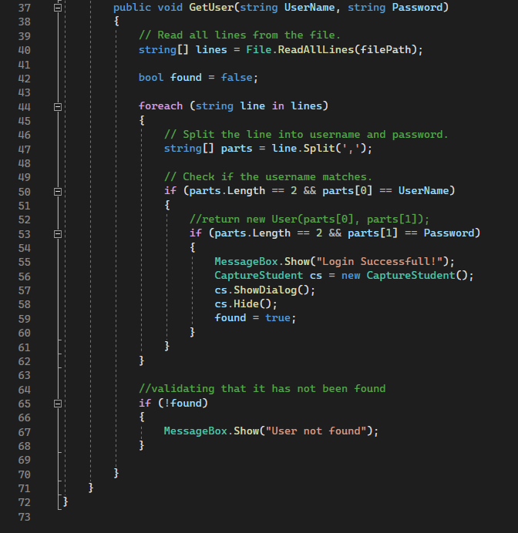
UserManager Class

Slide 16
Data Access Layer
The Data Access Layer is in charge of overseeing the exchange of information between the application and the data storage, which in this instance is a SQL Server database. It removes abstraction from the Business Logic Layer's specifics on data storage and retrieval.
Its duties include:
Interacting with the database to carry out CRUD procedures,
Carrying out instructions and SQL queries,
Taking care of database connections,
Translating data between the database format and the internal representation of the programme.

Slide 17
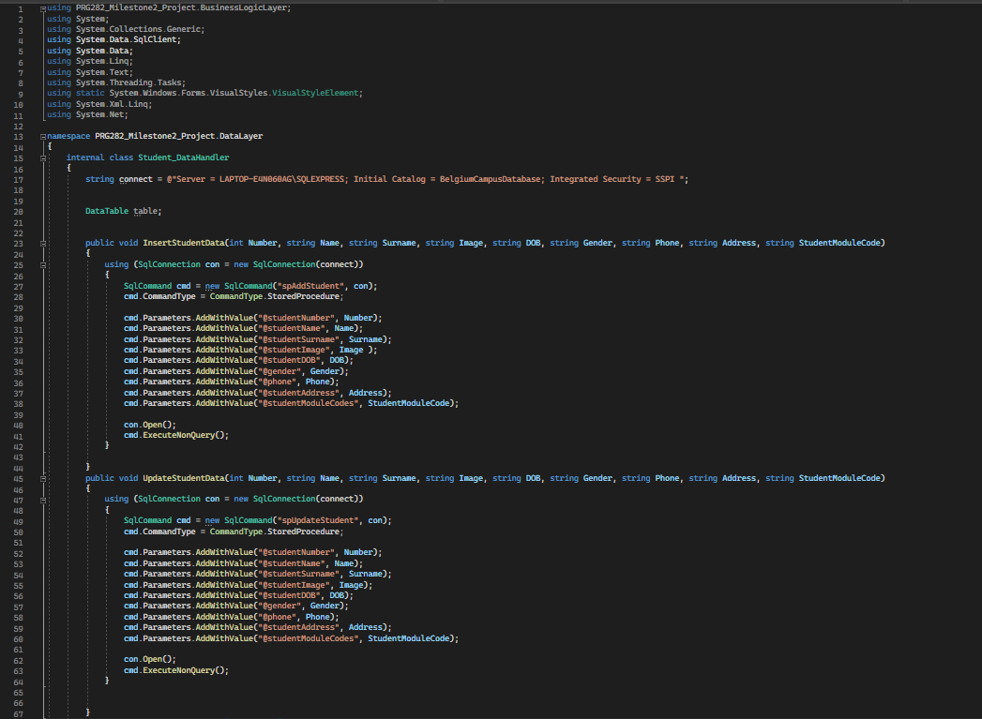
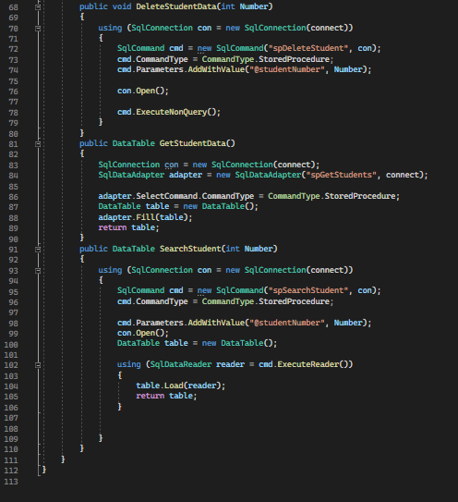
Student Data Handler

Slide 18
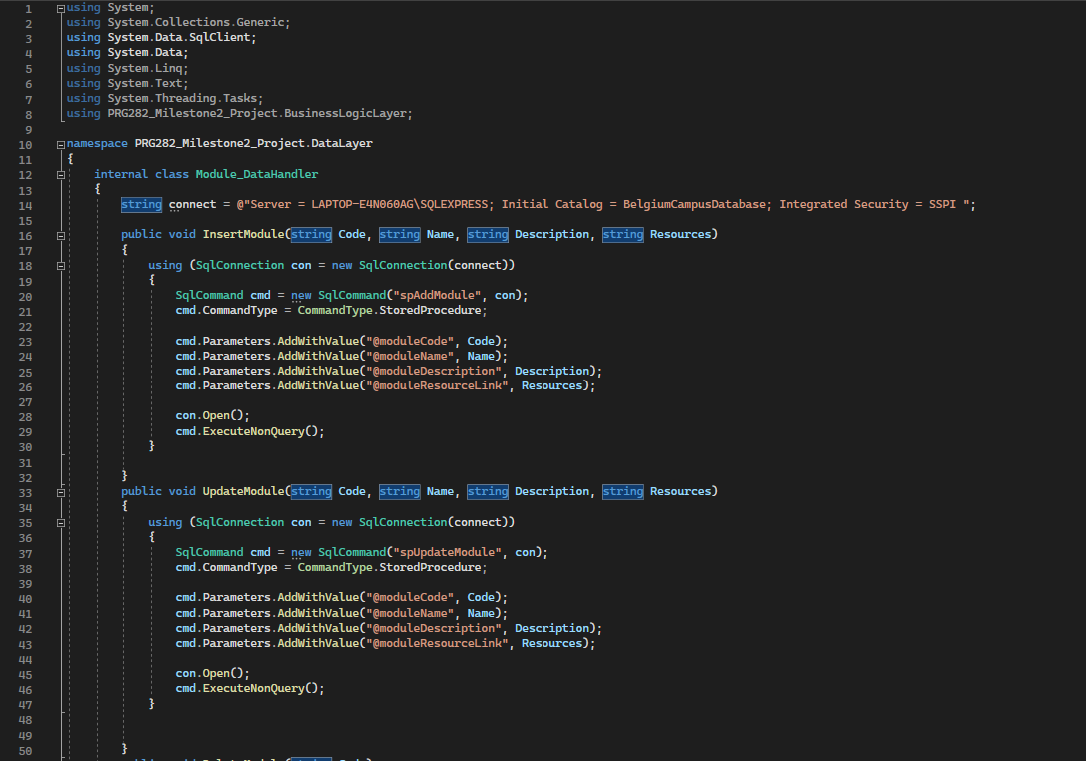
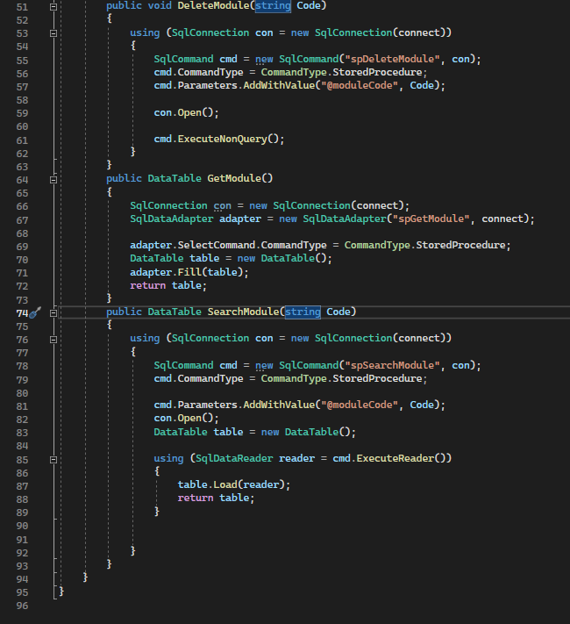
Module Data Handler

Slide 19
Data Layer
The real data is kept in a permanent state at the Data Layer. It consists of the database management system (DBMS) and every part used for data administration, retrieval, and storage.
Its responsibilities consist of:
Database: The actual storage where linkages are established, and data is arranged into tables,
Tables and Relationships: Specifying the database's fields, tables, and relationships amongst tables,
Database-level procedures and triggers that contain functionality are known as stored procedures and triggers. They are frequently employed for intricate tasks or to enforce business rules at the database level,
Indexes and Optimisation: To improve database performance, apply indexing and other optimisation strategies.

Slide 20

SQL DataBase: Create Database

Slide 21
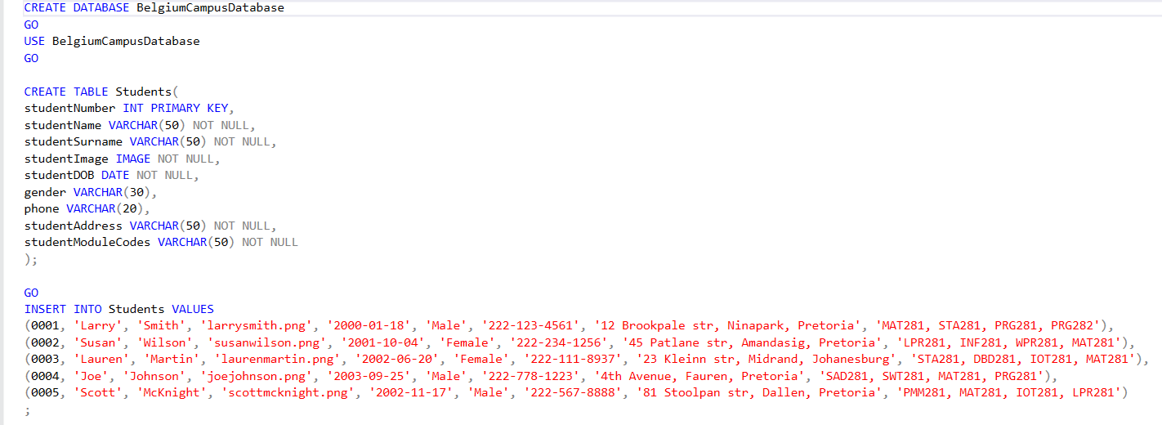
SQL DataBase: Students Table

Slide 22
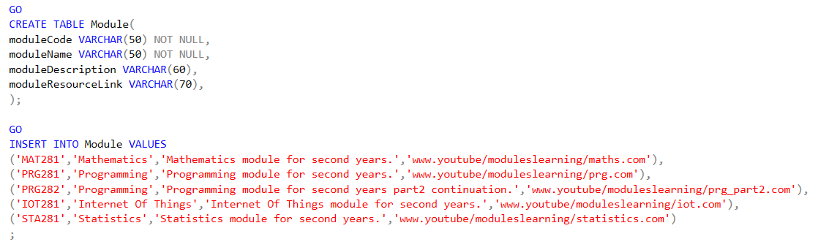
SQL DataBase: Module Table

